Slide 1
Welcome
To
Capstone project 2
Presentation

Slide 2
DataSpark : Illuminating Insights for Global Electronics
Global Electronics Is a leading retailer in the consumer electronics sector.
In this project, we will analyse large data from global electronics to find insights and actionable recommendations which will enhance business and identifies areas we have to improve.

Slide 3
OURS GOAL
Is to perform some EDA (exploratory data analysis) on datasets.
Importing cleaned datasets to SQL database.
Creating dashboards on power BI for different analysis.
Report generating to showcase valuable insights and actions for business growth.

Slide 4
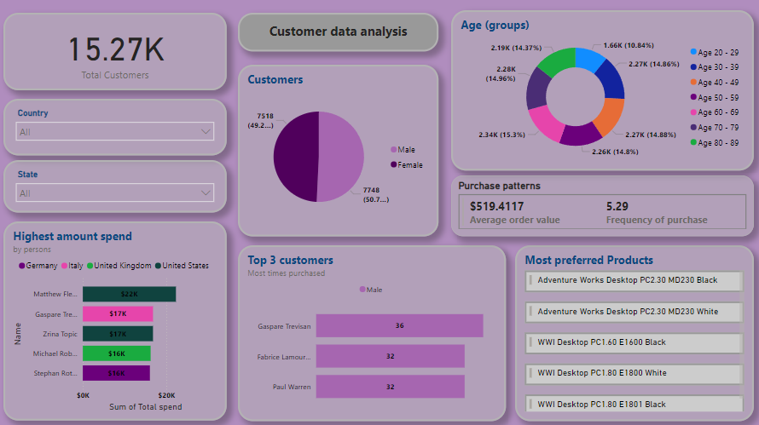
Customers dashboard

Slide 5
Insights
People from age group of 20 - 29 are least in all of age category. We have to attract this young age customers by selling trending gadgets.
Most of the customers preferred computers as their priority
There are almost equal no of customers in both genders (male slightly higher than female)
Highest amount spent customers is from USA.
Gaspare is the most time purchased customer (36 times)

Slide 6
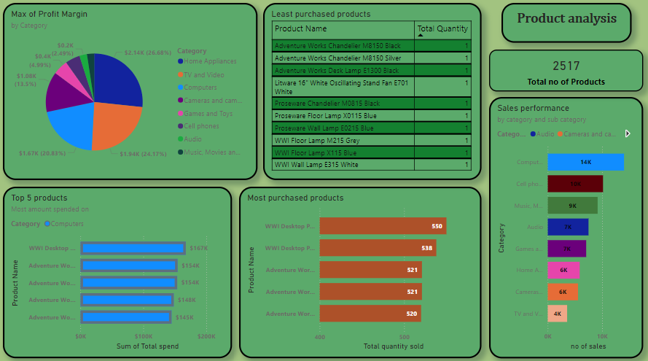
Product dashboard

Slide 7
insights
There are total 2517 unique products available
Home appliances occupies most profit margins ($2.14k)
Computers category are the highest performing category in sales ( over 14 thousand sales)
Most purchased product is WWI desktop (550 nos.)
Least purchased products are lamps and chandelier ( 1 nos.)

Slide 8
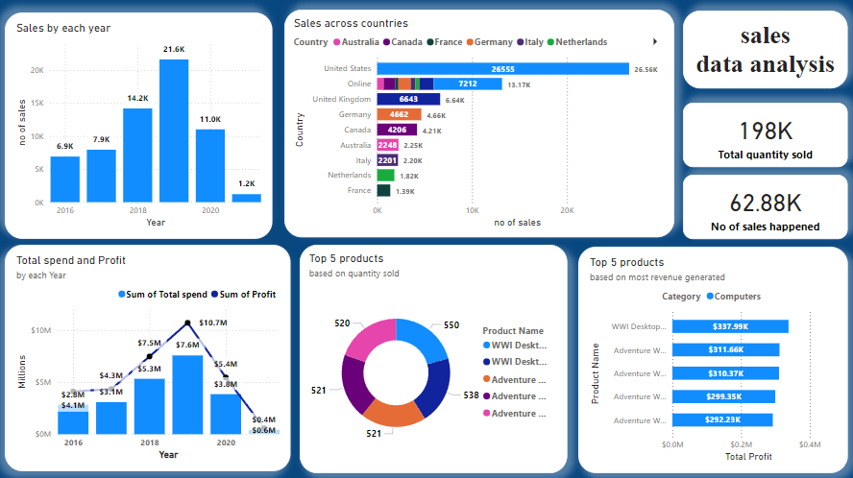
Sales dashboard

Slide 9
insights
Among all these six years - 2019 yr was the most no of sales achieved (21.6K nos).
in the year 2019 , we generated maximum profit of 3.1 MILLIONS.
United states registered the most no of sales which is 26.56K across all years.
WWI desktops are the most sold (550 nos) and most revenue ($ 338 K) generated product.

Slide 10
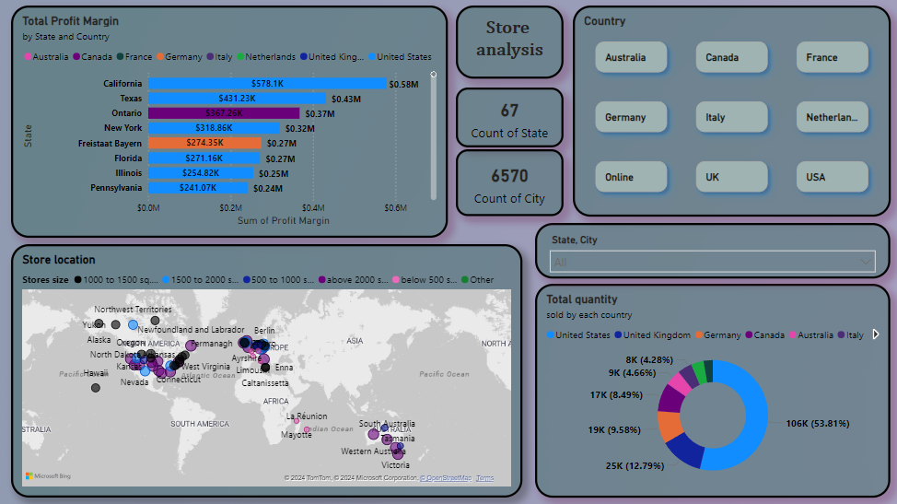
Store dashboard

Slide 11
insights
In the total of 66 stores most of stores size are between 1000 sq.M to 1500 sq.M (22 stores) and second most is stores above 2000 sq.M (21 stores)
United states have the highest profit $5,429 K (5.5 millions)
Highest profit is from California state which is $578.1K (0.58 millions)
Revenue generated through online shoping is 2.12 millons
Most product quantity sold in United States (106K nos.)

Slide 12
Recommended actions
Customer : we have to attract the customers from age group of 20 to 29 by selling trending products.
Product : we have to reduce selling lamp and chandelier (least purchased) and improve selling in computers and cell phones etc…
Sales : March and April are the lowest sales months, including products which are most used on summer would improve our sales performance.
Store : size of the store can be renovated according to their total profit , this would save some spending on the monthly rents. (Wyoming generating $0.23M where its store size is only 840 sq.M only and Tasmania generating $0.08M where its store size is 2000 sq.M)

